Slide 1
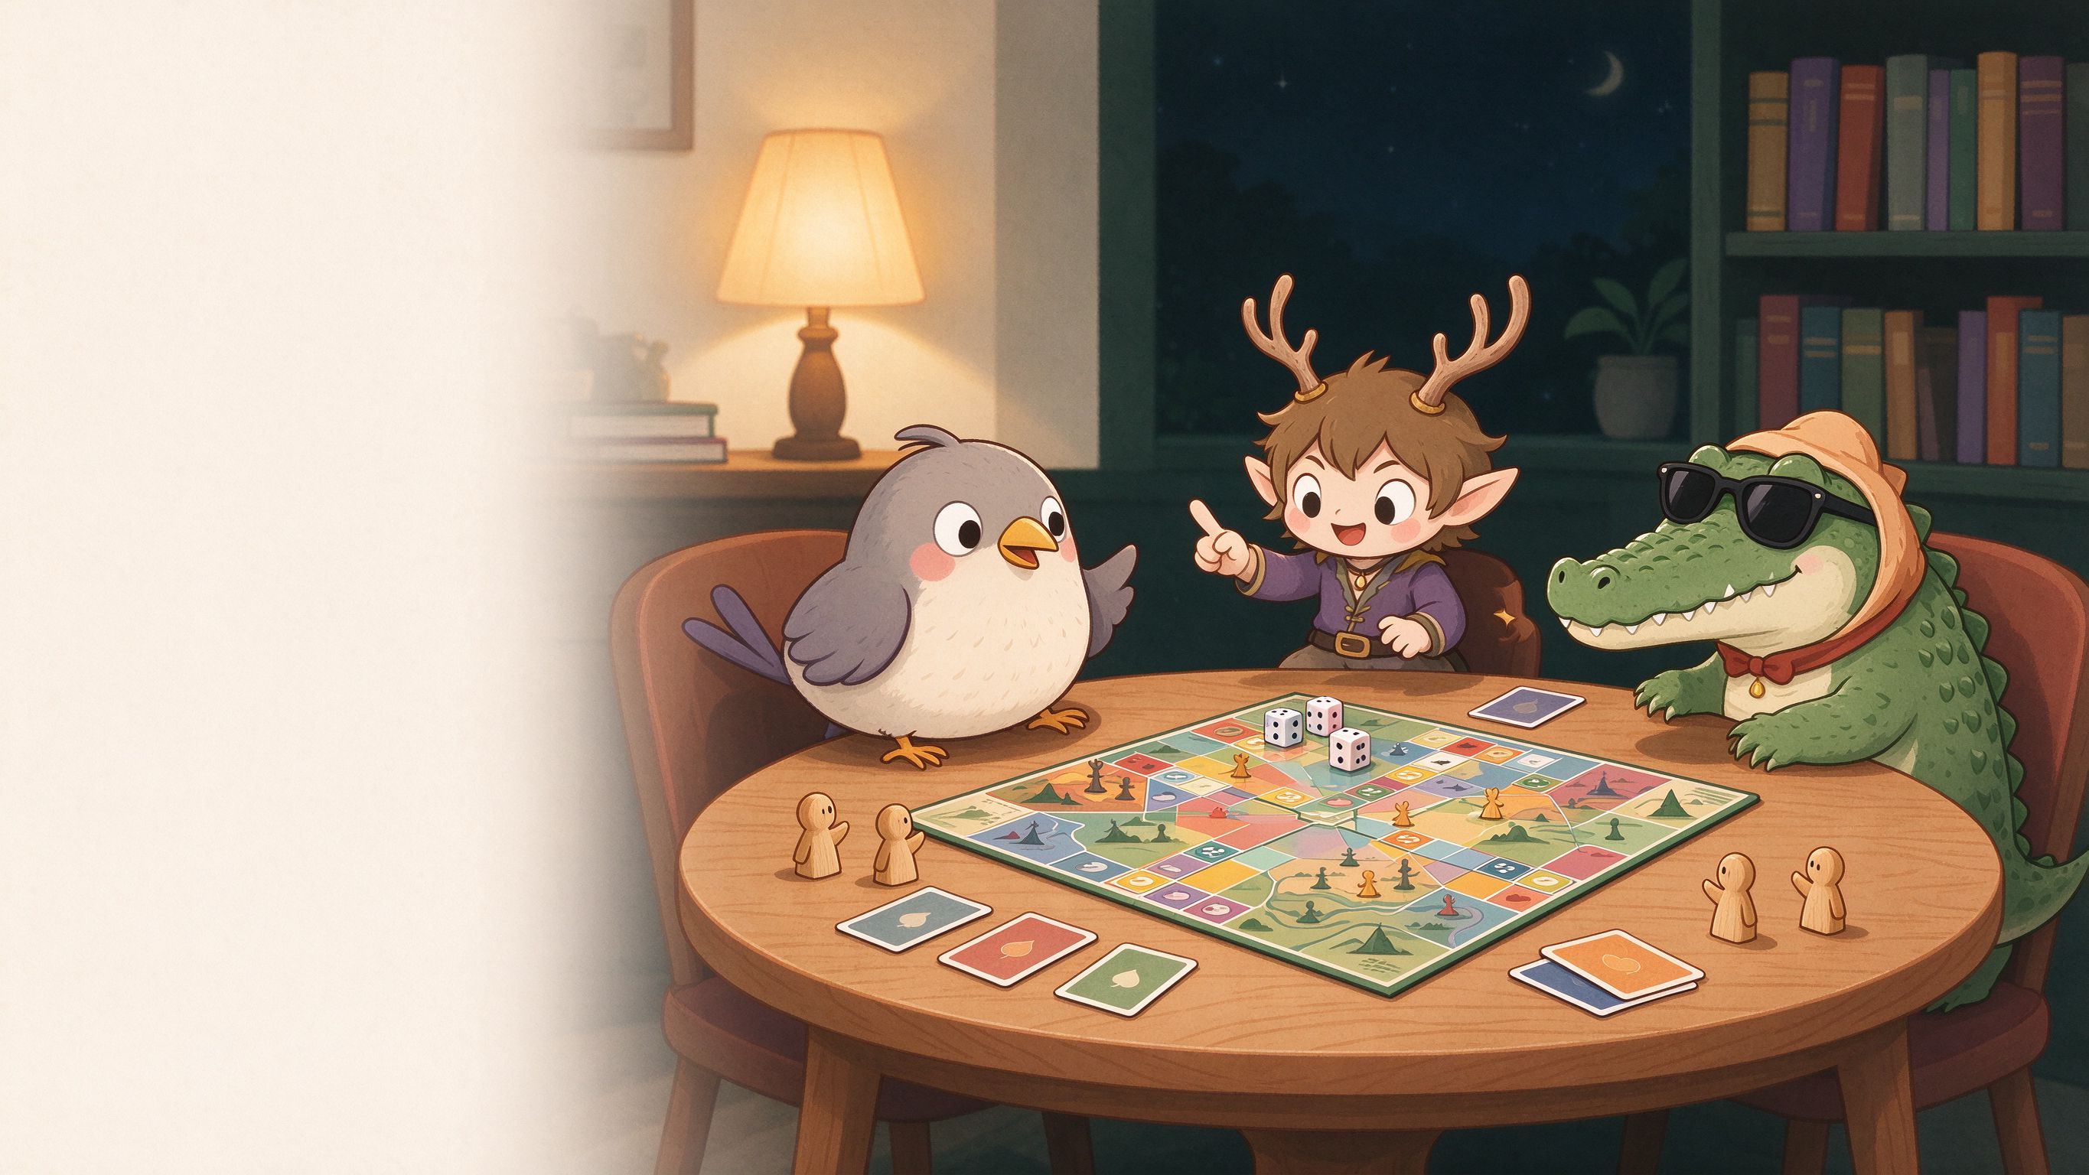
Notes:
Hi everyone! Quick question first: how long did it take you to pick a board game last time? Too long, right? We built something to fix that. I am [Name A], and this is [Name B] and [Name C]. Meet the Board Game Finder — two thousand seventy-seven real games, one fun answer.

Slide 2
01 · THE PROBLEM & THE DATA
Too many games.
Too little time.
~4,000 records fetched · 2,077 base games kept · every pick has ≥100 ratings
THE PROBLEM
THE FIX
THE DATA
Hundreds of options, ratings, playtimes and complexity levels. Picking a game feels like a second job.
One app turns the whole catalogue into plain language — tell it your table, your time and your mood.
2,077
base games after cleaning
~4,000 raw records fetched
every pick has ≥100 ratings
Data: BoardGameGeek public XML API · expansions, re-implementations and non-games removed
Notes:
[Name A] The problem is real: hundreds of options, ratings and complexity levels — picking a game feels like a second job. So we turned the whole BoardGameGeek catalogue into one playful finder. Quick numbers: we pulled about four thousand records, cleaned them down to two thousand seventy-seven base games, and every recommendation only uses games with at least one hundred community ratings.

Slide 3
02 · FIND ME A GAME
Tell it what you like.
It answers in seconds.
YOUR TABLE
EXAMPLE MATCH · TOP PICK
Players 2–5
Ticket to Ride
hard constraint — must fit your table
Fits your table: plays 2–5.
Runs about 45 minutes — right in your window.
Light complexity, easy to teach first-timers.
Playtime ≤ 45 min
switch between preferred and maximum
Complexity light–medium
set a hard ceiling if you want
2–5 PLAYERS
~45 MIN
COMPLEXITY 1.9
RATING 7.4
Quality rating ≥ 7.0
only games with ≥100 BGG ratings
score = 0.35·players + 0.20·time + 0.20·complexity + 0.25·rating
Notes:
[Name B] Now the app itself. Tell it your table size — say two to five players, under forty-five minutes, light complexity, a decent rating. It sorts all two thousand seventy-seven games with a transparent, weighted formula, and explains every pick in plain words. No black box: you always see why a game made the list.

Slide 4
03 · EXPLORE & SIMILAR
Not just a finder —
data and doppelgangers.
EXPLORE · INTERACTIVE
SIMILAR GAMES
Median rating 6.1 — most games sit 5.5–7.5
Love one game? Find its family.
Paste it in — get its closest cousins.
Complexity sweet spot — medium-weight scores highest
01 · Real signals — shared categories and mechanics, not vibes
02 · One pick per series — no five versions of the same game
03 · Honest score — similarity of features, not a promise you will like it
Top categories — card, family and party games lead
Catalogue growth — more choice every decade
All five charts are interactive in the app
Example: paste Catan → get family-style strategy picks, not reprints
Notes:
[Name B] Before recommending anything, we explored the data — all of it interactive in the app: most games sit around six point one, medium complexity tends to score highest, a few categories dominate, and the catalogue keeps growing. And if you already love one game? Paste it in, and it finds its family — matched on shared categories and mechanics, one pick per series, with an honest similarity score. It is similarity of features, not a promise you will like it.

Slide 5
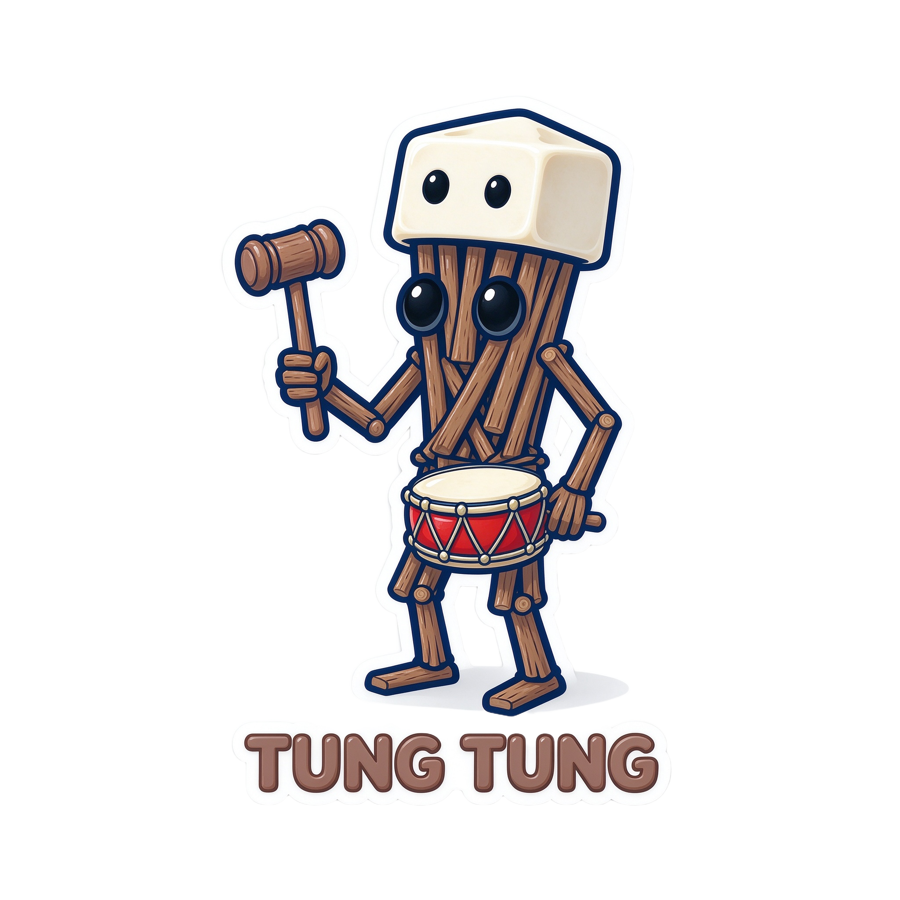

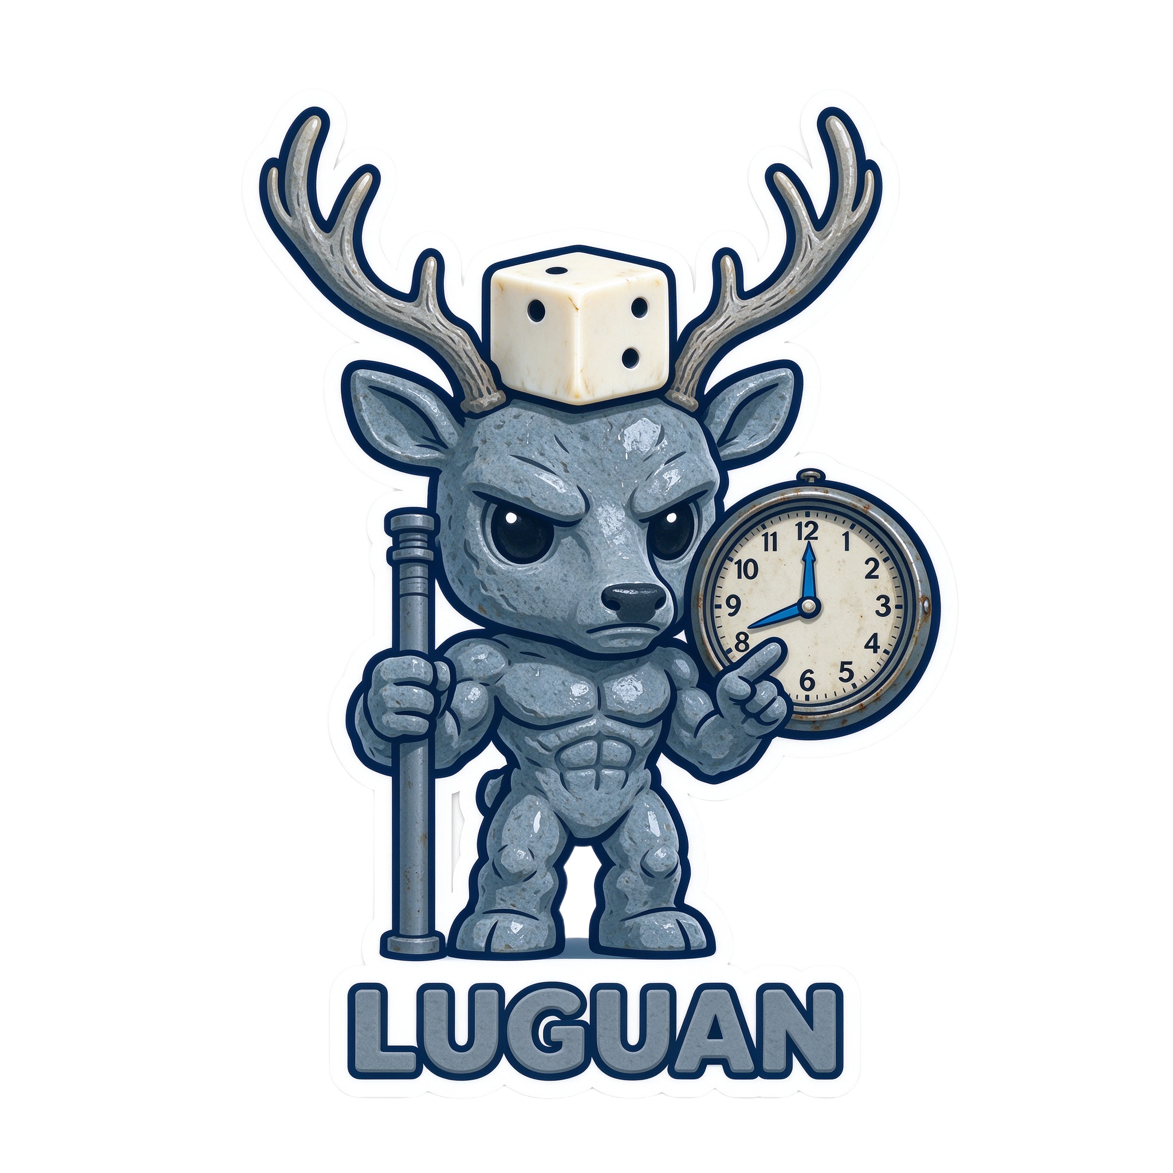

04 · BOARD GAME BESTIARY
Not a quiz —
a personality test for board gamers.
8 quick questions · meet your beast · get 3 real game picks
The City Builder
The Party Animal
The Rule Sheriff
The Bombardier
Each beast maps to three real games from our 2,077 — no imaginary picks.
It is our silly, sticky way to do recommendations.
Notes:
[Name C] Our favourite page — the Board Game Bestiary. Answer eight quick questions and meet your beast: the City Builder, the Party Animal, the Rule Sheriff, or the Bombardier. Each beast maps to three real games from our catalogue — no imaginary picks. It is our silly, sticky way of doing recommendations. So, quick show of hands — who wants to know their beast?

Slide 6

Roll the dice.
Meet your beast.
Find your game.
Try it live · the code is open source
github.com/your-team/board-game-finder
100% Python — cleaning, machine learning and this app · one script from repo to running
Thank you — we would love your questions!
Notes:
[Name C] Everything you saw is Python, from the data pipeline to the models to this app — and it is open source: one script gets you from our repo to a running app. So roll the dice, meet your beast, find your game. Thank you — we would love your questions!

